Slide 1
Thermo-Mechanics
NE 591

Slide 2
Last Time
Overviewed thermal expansion
Thermal expansion can cause stress when
Deformation is constrained
There are gradients in the expansion coefficient
There is a temperature gradient
We have analytical equations for thermal stresses in the cladding and in the fuel
Demonstrated need for iteration to obtain steady-state gap thickness
Developed 2D-RZ equations for stress and strain for axisymmetric system

Slide 3
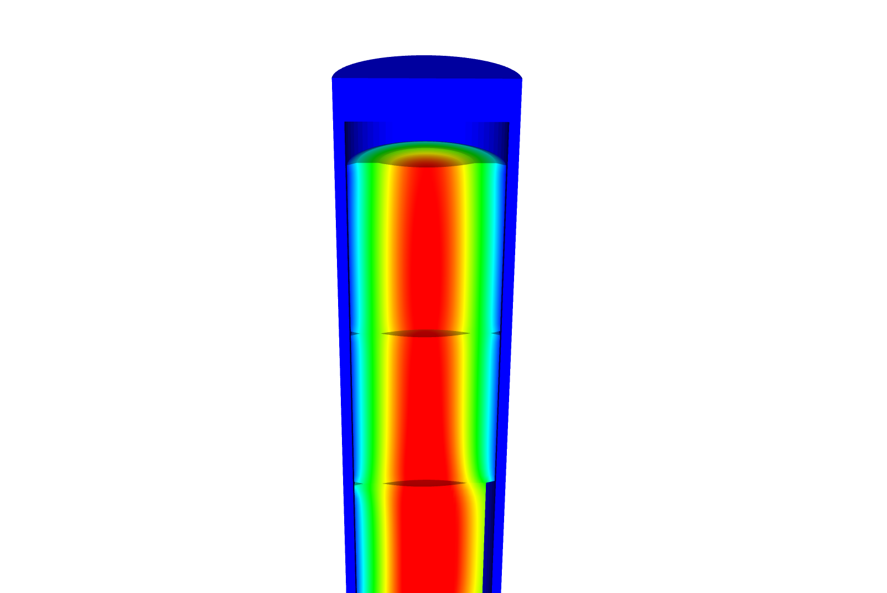
Now we can solve the temperature and the displacement vector for the full thermomechanical problem
T impacts the value of u through thermal expansion
u impacts the value of T through changes in the thickness of the gap
The value for T evolves with time
The value for u also evolves with time, even though there is not time in its PDE

Slide 4
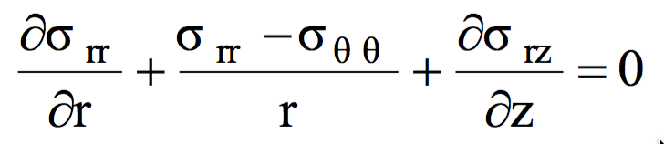
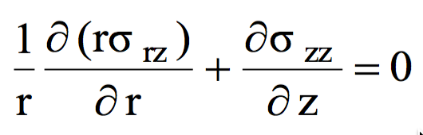
Assuming problem is axisymmetric

Slide 5
Solve for the stress from the strain
Assume isotropic materials
The hoop strain is included in the calculation of the stress

Slide 6
Further simplify the problem to be 1D
No change in Z:

Slide 7
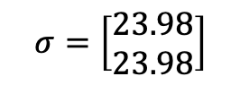
Determine the strain and stress in the pellet for 1D case
Assume the radial displacement in the fuel pellet is u_{r}(r) = 0.05r cm.
What is the strain tensor at the center and at the outer edge?
We are dealing with UO₂, so E = 200 GPa and ν = 0.345
C₁₁ = E (1 – ν)/((1+ν)( 1–2 ν)) = 200*(1–0.345)/(1.345*(1–2*.345)) = 314.2 Gpa
C₁₂ = E ν/((1+ν)( 1–2 ν)) = 200*0.345/(1.345*(1–2*.345)) = 165.5 Gpa
Now we can calculate the stresses
σ_{rr} = 0.05*314.2 + 0.05*165.5 = 23.98 GPa
σ_{θθ} = 0.05*314.2 + 0.05*165.5 = 23.98 GPa
$$σ=\left[\begin{matrix}23.98 \\ 23.98\end{matrix}\right]$$

Slide 8
Example problem
Compute the stress and strain tensors in the center and at the outer edge (r = 0.5 cm) in 1D axisymmetric coordinates in a fuel pellet with u_{r}(r) = r²/5. C₁₁ = 314.2 Gpa, C₁₂ = 165.5 Gpa.
First, calculate the strain tensor
ε_{rr} = u_{r,r} = 2r/5
ε_{θθ} = u_{r}/4 = r/5
At the center there is no strain; at the outer edge
To calculate the stress, convert to a strain vector and multiply by elastic constant matrix
The stress in the center is zero
On the outer edge
σ_{rr} = 0.2*314.2 + 0.1*165.5 = 79.4 GPa
σ_{θθ} = 0.1*314.2 + 0.2*165.5 = 64.52 GPa

Slide 9
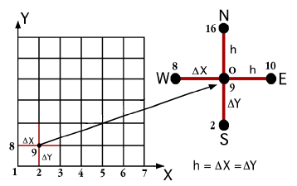
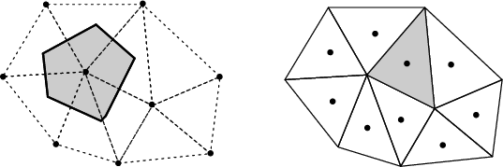

The primary tool for solving all thermomechanics problems is the finite element method
Finite difference
Can solve the heat conduction equation
Can’t easily solve the mechanics equations
Finite Volume
Can solve the heat conduction equation
Can’t easily solve the mechanics equations
Finite Element
Can solve the heat conduction equation
Can solve the mechanics equations
Can handle any geometry
Can handle any boundary condition

Slide 10
The 1D thermomechanics problem definition
dT/dr = 0
u_{r} = 0
R_{f}
T_{r} = T_{s}
du_{r}/dr = 0
r
The initial temperature is set to 273 K
We will take 50 time steps of 0.5 s
The full power of Q = 450 begins at time t = 0.
UO₂ material properties are used for both the thermal and mechanics equations

Slide 11
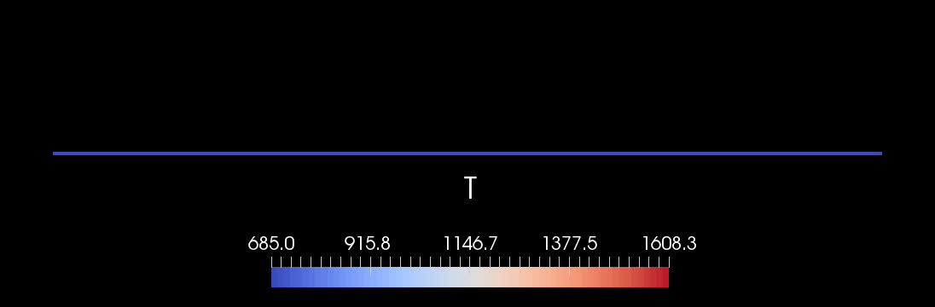
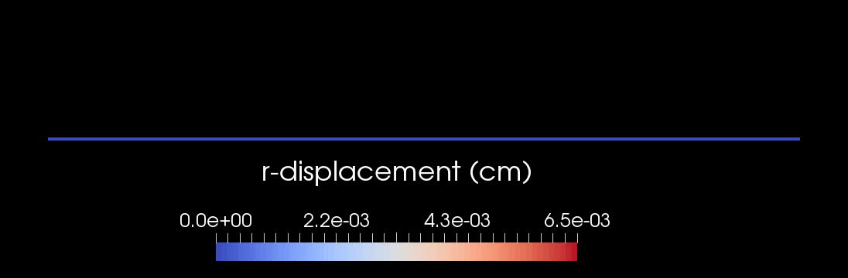


Slide 12
Comparison to analytical theory
If we use a constant thermal conductivity, analytical 1D model matches very well
When k is a function of temperature, there is a difference between the FEM and analytical stress

Slide 13
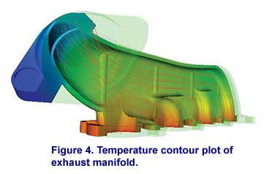
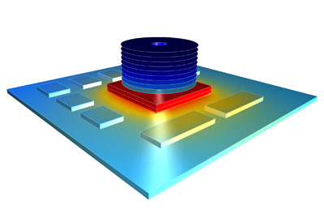

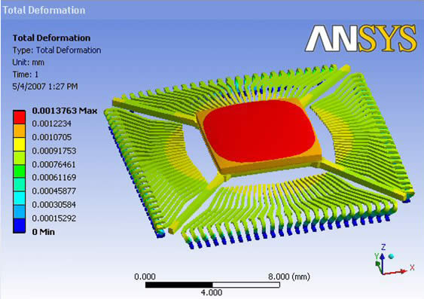

There are various available tools for solving coupled thermomechanical problems with FEM
Commercial tools
ABAQUS
ANSYS
COMSOL
Open source
MOOSE
NRC-based
FRAPCON/FRAPTRAN

Slide 14
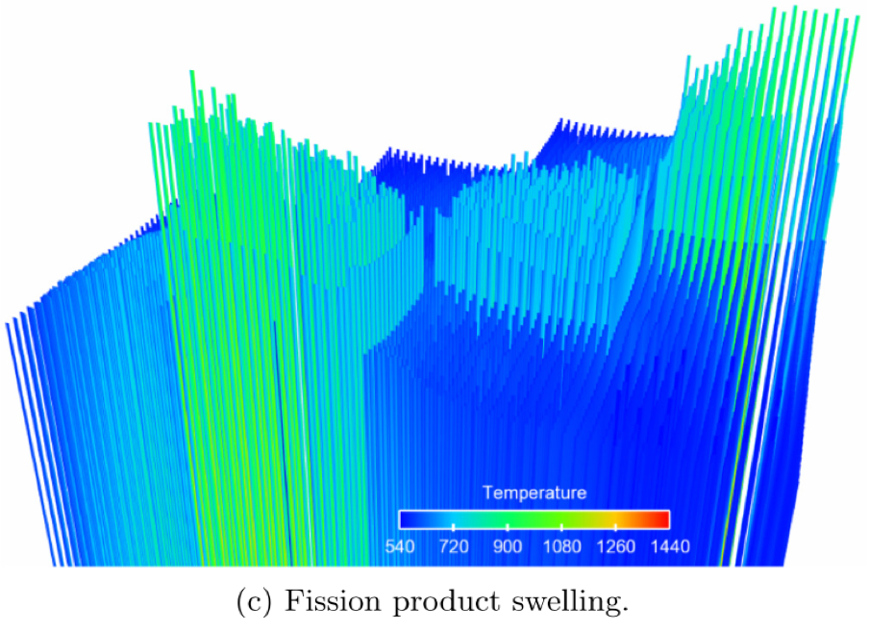

The purpose of a fuel performance code is to simulate and evaluate fuel rod behavior
The first fuel performance codes were developed in the mid seventies
Advanced fuel performance codes are still under development today
KAIST-3A benchmark results, showing displacement of 3432 rods, from Gaston et al. 2014

Slide 15
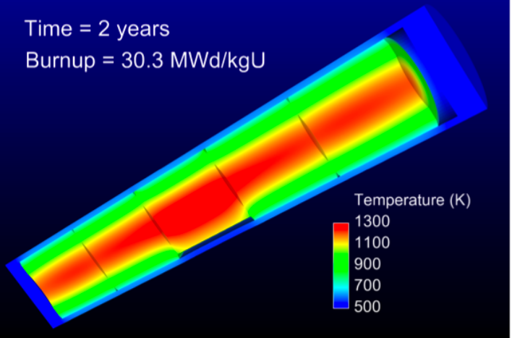
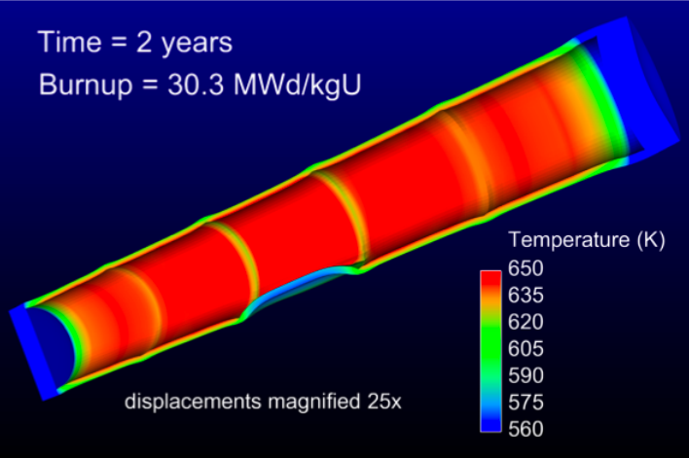
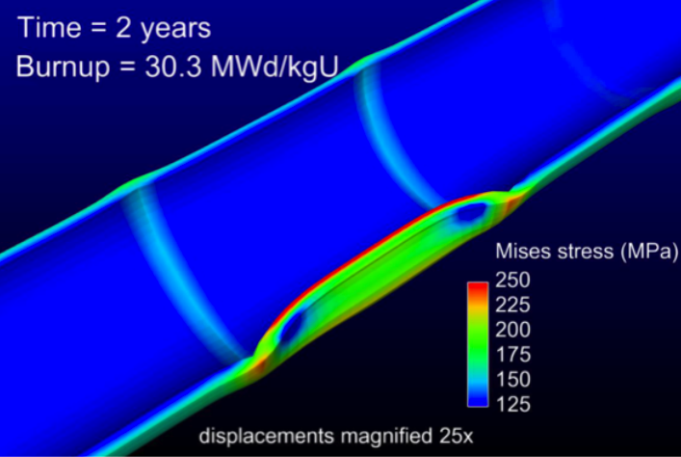
How are fuel performance codes used?
The primary goals are to predict the fuel centerline temperature and the stress in the cladding
Fuel performance codes aren’t focused on predicting power production, but rather to predict safety margins

Slide 16
A fuel performance code must be able to predict:
Fuel
Temperature profile
Volumetric change
Gap
Gap heat transport
Mechanical interaction between fuel and cladding
Gap pressure
Cladding
Temperature profile
Stress

Slide 17
The primary focus is solving the thermomechanical problem
Fuel
Solved Numerically
Gap
The handling of the gap changes the most between different codes
Solved Numerically or analytically
Cladding
Solved Numerically or analytically
Solved Numerically

Slide 18

Various approaches to model the fuel rod
Transient, full 3D
Transient, 2D axisymmetric with discrete pellets
Computational cost
Accuracy
Transient, 2D axisymmetric with smeared pellets
Transient, multiple 1D slices (1.5D)
Steady, multiple 1D slices (1.5 D)
Transient, 1D
Steady state, 1D (analytical)

Slide 19
Early fuel performance codes were made for either steady state or transient operation
Steady state codes
Leave of the time derivative part of the heat equation
The material properties still evolve with time as a function of burnup
The volumetric changes in the fuel are also a function of burnup
Creep of fuel and cladding change with time
Transient codes
Include the time derivative
Have similar burnup dependent models like steady state codes, but don’t include creep
Have additional models for rapid transients

Slide 20
Start with FRAPCON
Transient, full 3D
Transient, 2D axisymmetric with discrete pellets
Computational cost
Accuracy
Transient, 2D axisymmetric with smeared pellets
Transient, multiple 1D slices (1.5D)
Steady, multiple 1D slices (1.5 D)
Transient, 1D
Steady state, 1D (analytical)

Slide 21
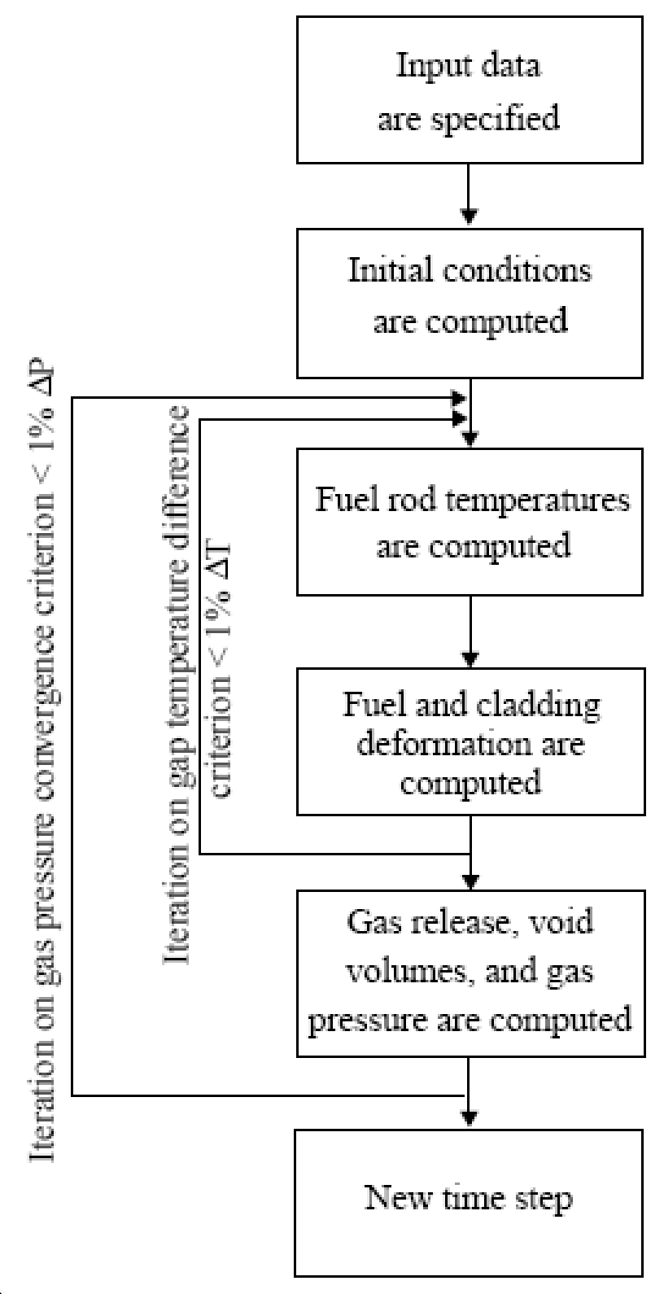
FRAPCON Flow Chart
FRAPCON iterates to determine fuel rod temperatures, fuel and cladding deformation
This converged data is iterated to produce gas release, void volumes and plenum pressure
Then marches forward in time

Slide 22
FRAPTRAN
Transient, full 3D
Transient, 2D axisymmetric with discrete pellets
Computational cost
Accuracy
Transient, 2D axisymmetric with smeared pellets
Transient, multiple 1D slices (1.5D)
Steady, multiple 1D slices (1.5 D)
Transient, 1D
Steady state, 1D (analytical)

Slide 23
FALCON
Transient, full 3D
Transient, 2D axisymmetric with discrete pellets
Computational cost
Accuracy
Transient, 2D axisymmetric with smeared pellets
Transient, multiple 1D slices (1.5D)
Steady, multiple 1D slices (1.5 D)
Transient, 1D
Steady state, 1D (analytical)

Slide 24
FALCON
FALCON is a 2D fuel performance code developed by EPRI
Development of FALCON started in 1996
The beta version was released in 2003
It was developed by ANATECH for EPRI
FALCON is proprietary, owned by EPRI
It is no longer under active development in the US

Slide 25
FALCON is a 2D transient and steady state code
Fuel
Solved with FEM
Gap
Pressure is calculated using equation of state
Simplified contact model is used for gap closure
Gap heat transfer model is used
Solved with FEM
Cladding
Solved with FEM
Solved with FEM

Slide 26
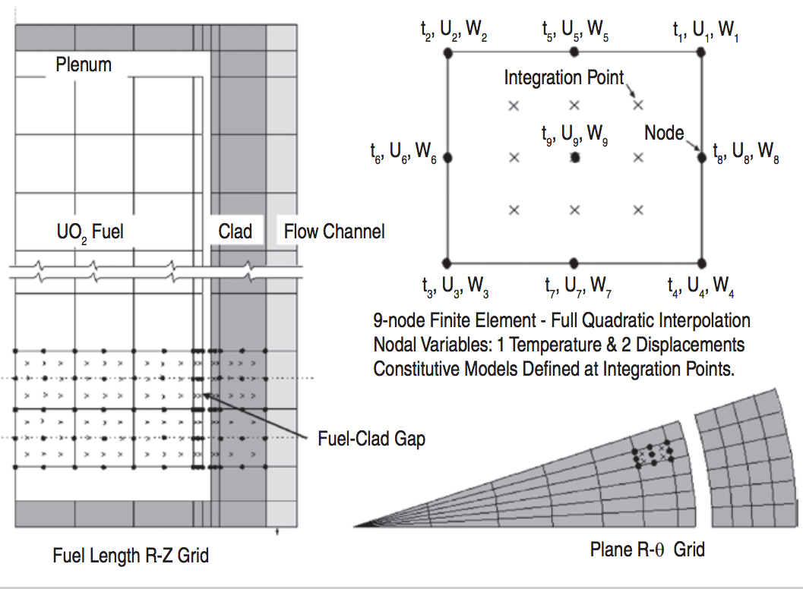
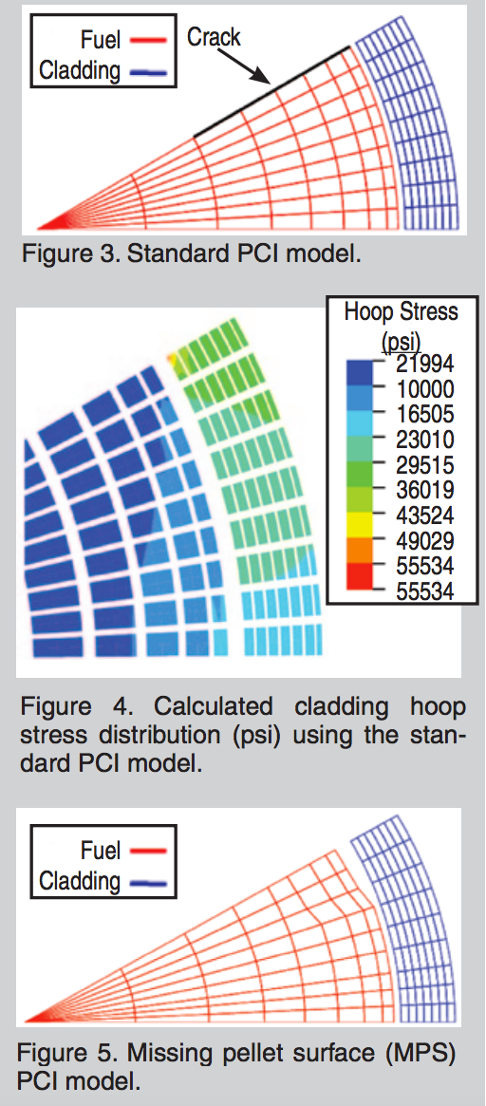
FALCON can predict the fuel performance in axisymmetric RZ space or in Rθ space

Slide 27
BISON
Transient, full 3D
Transient, 2D axisymmetric with discrete pellets
Computational cost
Accuracy
Transient, 2D axisymmetric with smeared pellets
Transient, multiple 1D slices (1.5D)
Steady, multiple 1D slices (1.5 D)
Transient, 1D
Steady state, 1D (analytical)

Slide 28
BISON
The next generation fuel performance code under development in the US
It uses the MOOSE framework
Development was begun in 2008
The first paper using BISON was published in 2009 and the paper summarizing its full capabilities was published in 2012
It was developed at Idaho National Laboratory, with some support by ANATECH
BISON is available for free, but it is export controlled and requires a license agreement be signed

Slide 29
BISON models the fuel behavior ranging from 1D to full 3D and uses FEM
Fuel
Solved with FEM
Gap
Pressure is calculated using equation of state
Fully implemented implicit contact algorithm
Gap heat transfer model is used
Solved with FEM
Cladding
Solved with FEM
Solved with FEM

Slide 30
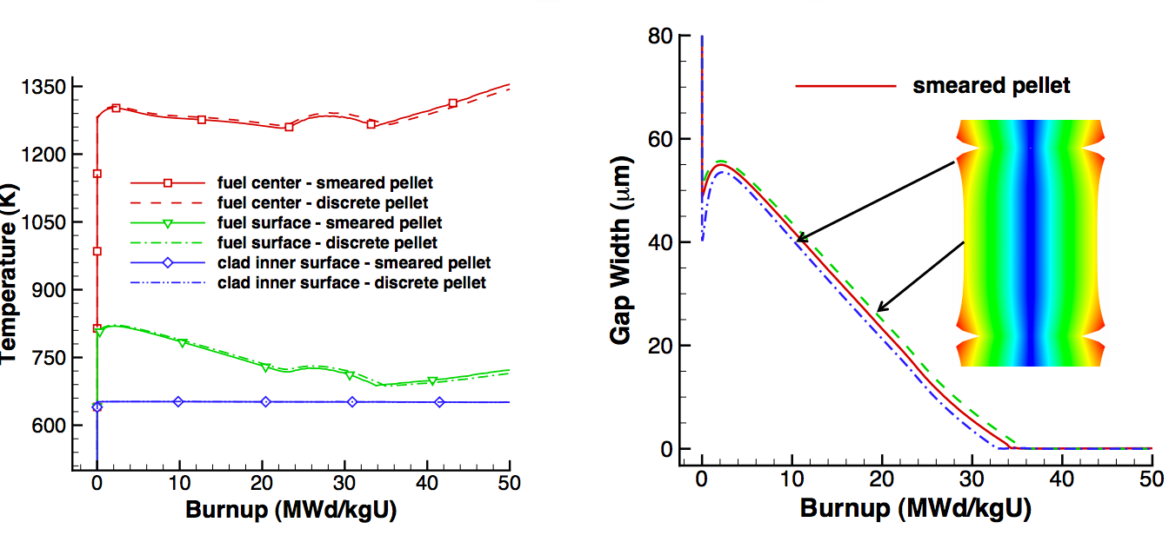
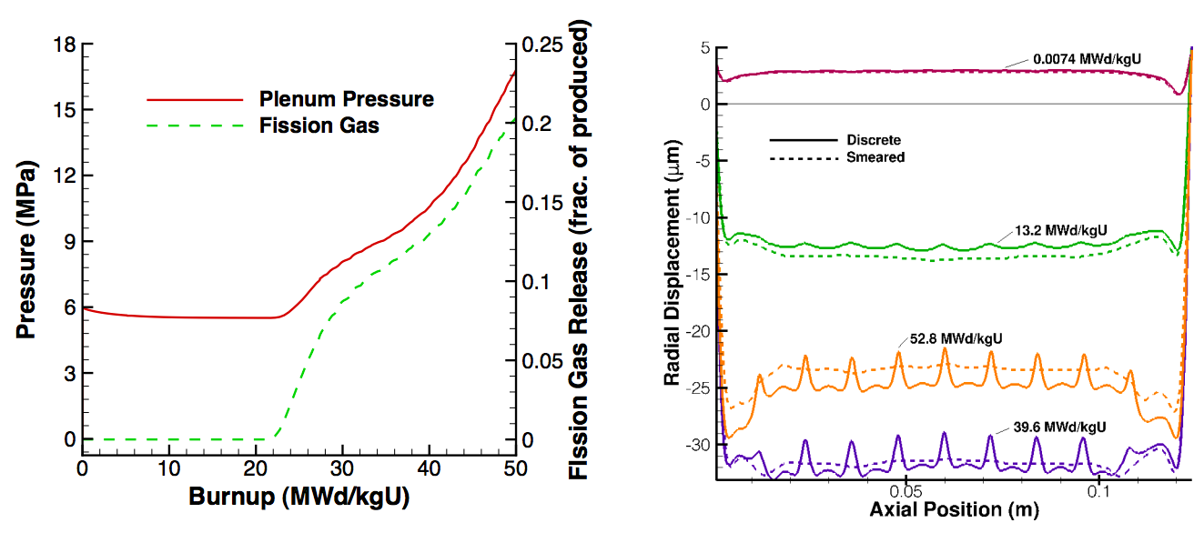
Can handle smeared or discrete pellets, asymmetric pellet geometry and deformation

Slide 31
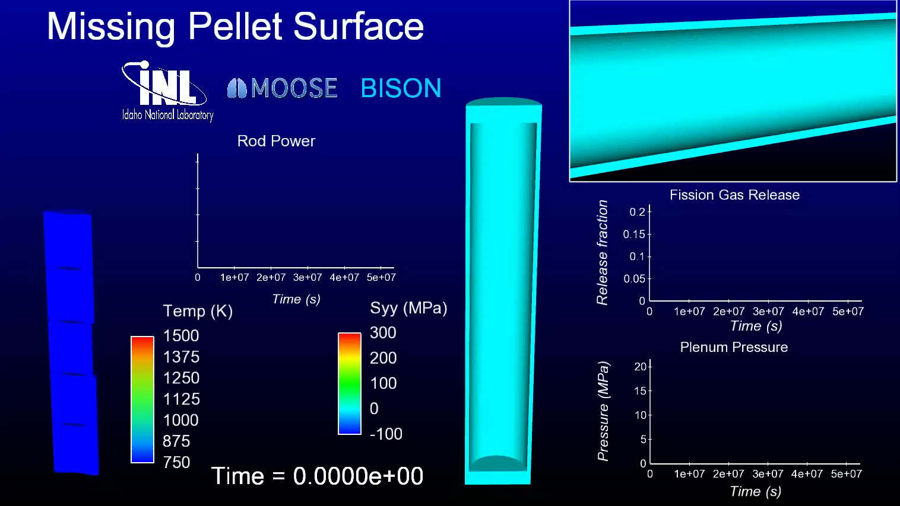
Because of its unique 3D capability, BISON can model truly 3D fuel performance problems

Slide 32
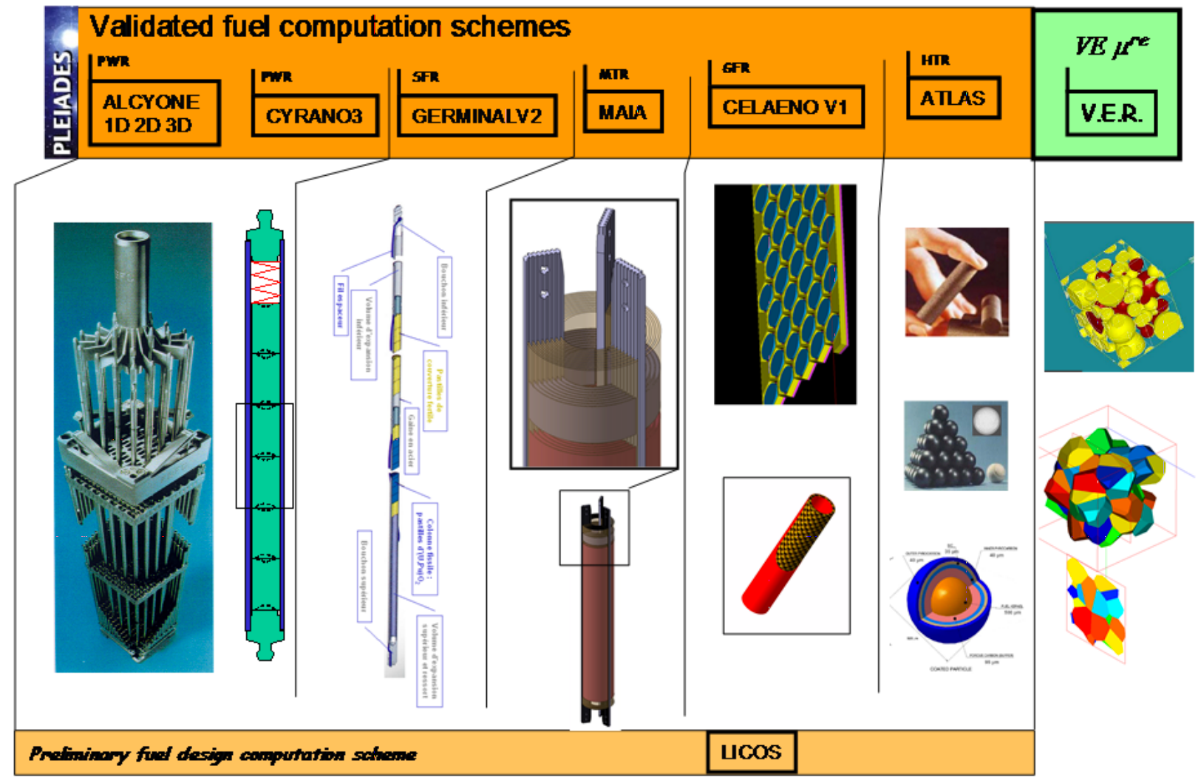
Other countries have other fuel performance codes
TRANSURANUS: ITU (Germany)
ALCYONE: CEA (France)
ENIGMA: NNL (UK)
FEMAXI-7: JAEA (Japan)
SFPR: IBRAE (Russia)
DIONISIO: (Argentina)
http://www.materials.cea.fr/en/PDF/PLEIADES-Platform.pdf

Slide 33
Summary
Fuel performance codes are focused on predict the center temperature of the pellet and the stress in the cladding
All fuel performance codes
Numerically model the temperature in the fuel
Numerically model the stress in the cladding
And consider gap pressure, closure, and heat transfer in some way
The primary US codes are
FRAPCON – Steady state 1.5D, uses finite difference
FRAPTRAN – Transient 1.5D, uses finite difference
FALCON – Steady or transient 2D, uses finite element
BISON – Steady or transient, 1D – 3D, uses finite element

Slide 34
Paper assignment
I have assigned each of you a paper to read and review
We will have 15 minute presentations from each person on February 27 summarizing and analyzing their respective paper
Papers will be emailed out today

Slide 35
MOOSE Training Extra Credit
March 9-11
Applied for access to FRAPCON/FRAPTRAN, but still processing, so may need to utilize MOOSE or ANSYS or ABAQUS
INL folks are coming to NCSU for a regional MOOSE training
Not required, but will get extra credit for attendance, +4 to total grade
Also, this is a very good skill to have for a graduate student, MOOSE suite of tools can do a lot
Neutron transport, thermal hydraulics, phase-field, risk analysis, fuel performance, systems analysis, etc.

